Slide 1

EXPLORATORY DATA ANALYSIS OF TOP ENGINEERING COLLEGES IN INDIA
BATCH NO: 324
B. PRAVEEN
MD. SANIYA

Slide 2

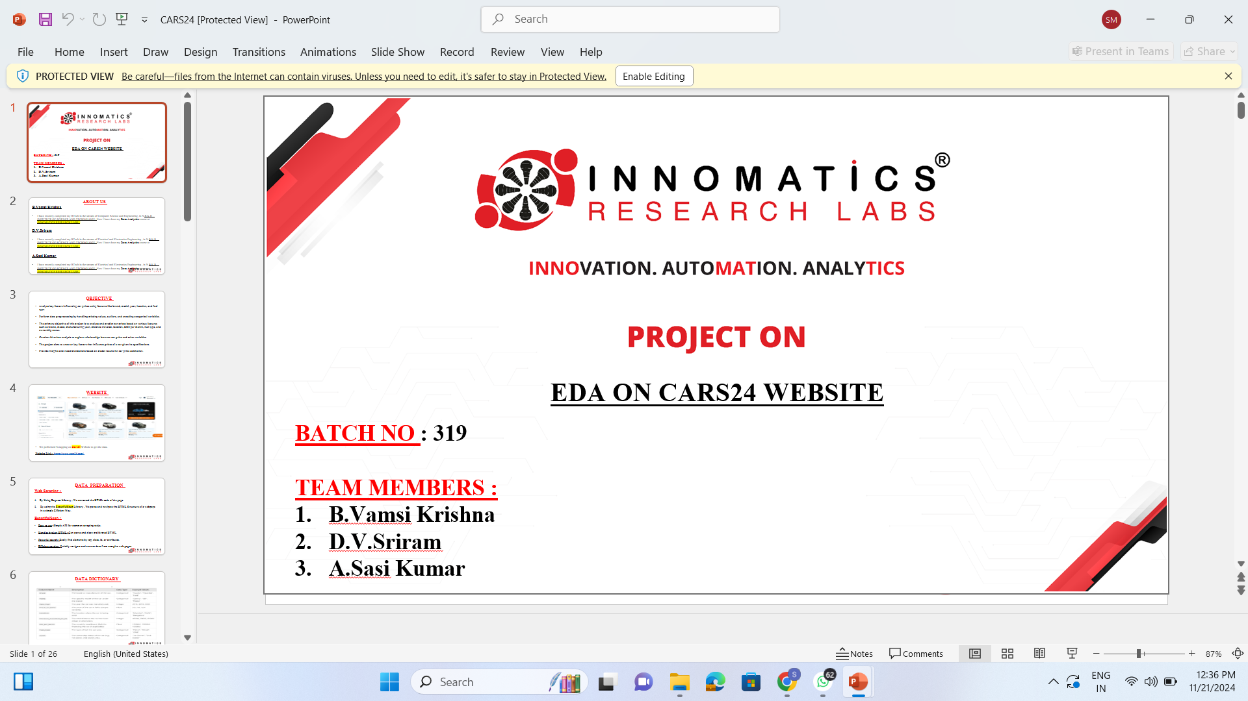
PROBLEM STATEMENT
The Indian higher education sector offers numerous top colleges. However, understanding factors like fees, course offerings, rankings, and student reviews is critical for making an informed decision about the best college for your academic and career goals."
Determine how ratings influence student preferences and the number of brochures downloaded.
Evaluate the variation in B.Tech fees among top-ranked colleges
Compare M.Tech and B.Tech fees to assess differences in cost structure and accessibility.
Identify the correlation between college rankings and factors such as fees, ratings, and student interest.
Career 360 Website

Slide 3
INTRODUCTION
The Engineering Colleges dataset provides comprehensive insights into key factors influencing the selection and reputation of engineering institutions in India. This offers a holistic view of college performance, affordability, and popularity. The dataset also highlights variations in B.Tech and M.Tech fees, helping to assess affordability and accessibility across institutions. Additionally, the brochures downloaded metric serves as a measure of student interest and demand, indicating which colleges are most sought after. This dataset serves as a valuable resource for analyzing trends, identifying disparities, and making data-driven decisions to improve the quality and accessibility of engineering education.

Slide 4
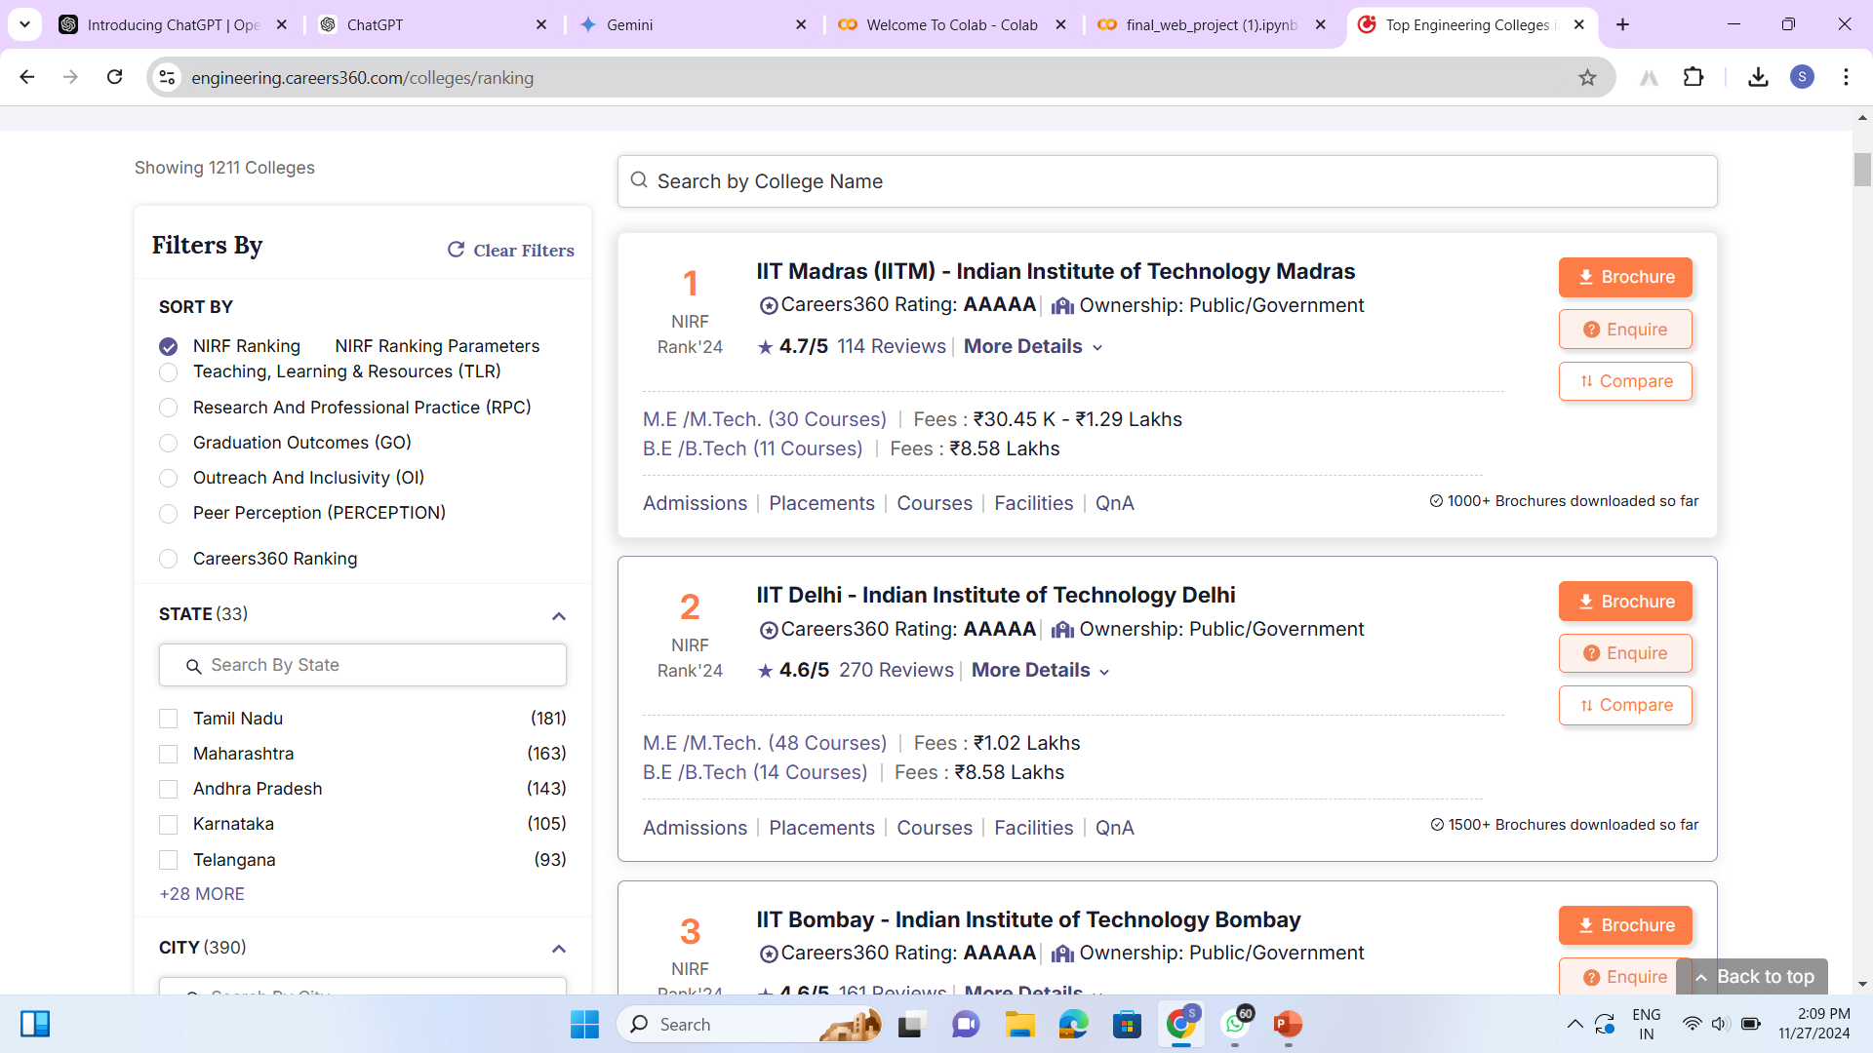
DATA COLLECTION
Website Link: https://engineering.careers360.com/colleges/ranking

Slide 5
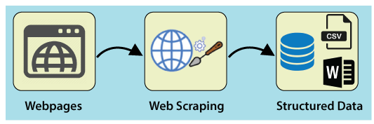
WEB SCRAPING
What is web scraping?
Tools like BeautifulSoup BS4 help parse and navigate html or xml content for data extraction.
Why BeautifulSoup?
Integrates with libraries like requests for fetching webpage data.

Slide 6


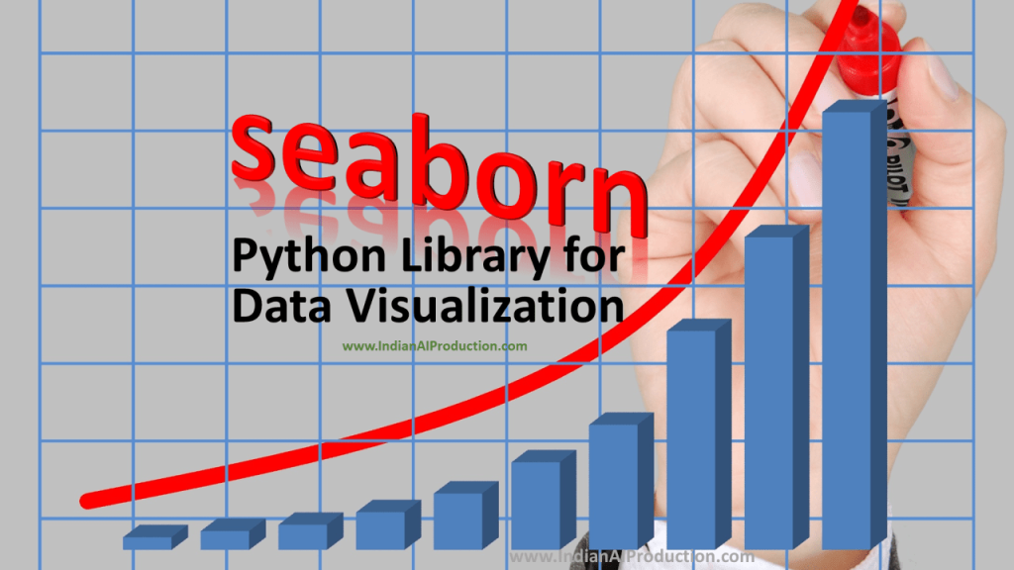

LIBRARIES USED
Requests
BeautifulSoup
Re
NumPy
Pandas
Matplotlib
Seaborn
Python

Slide 7
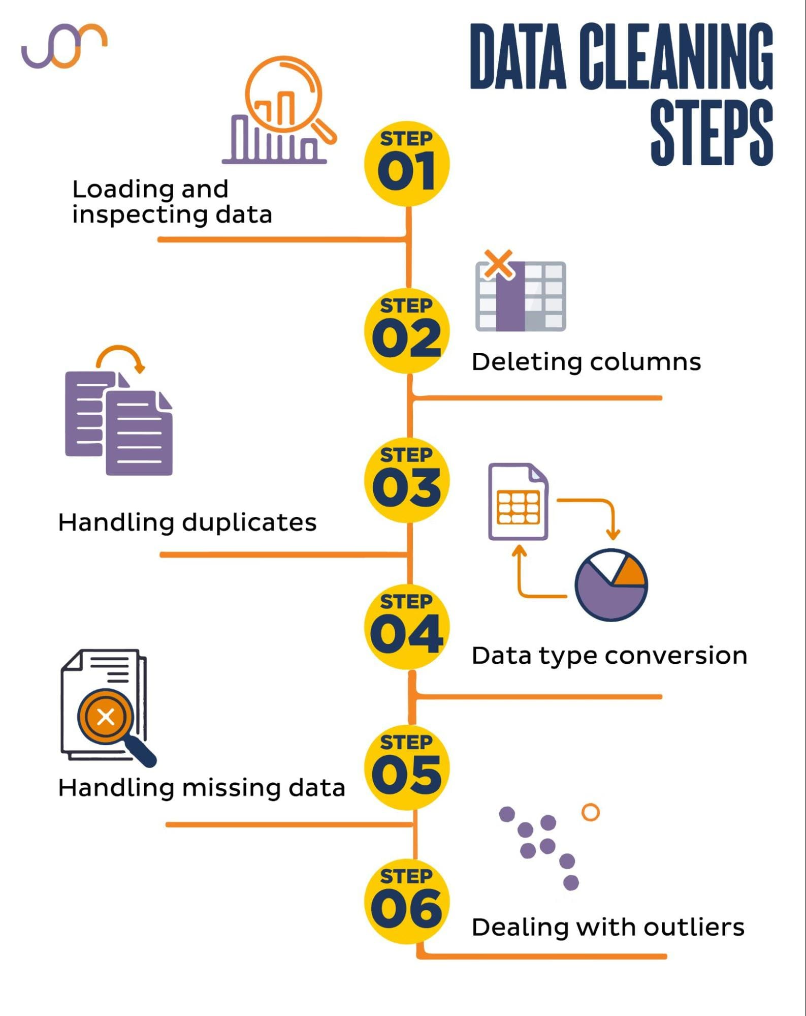

Slide 8
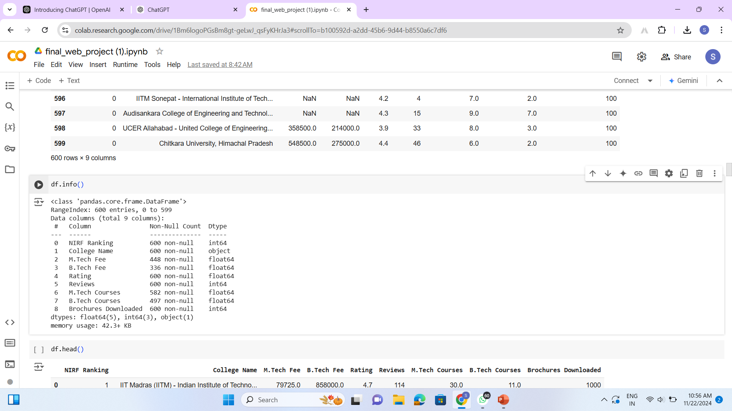
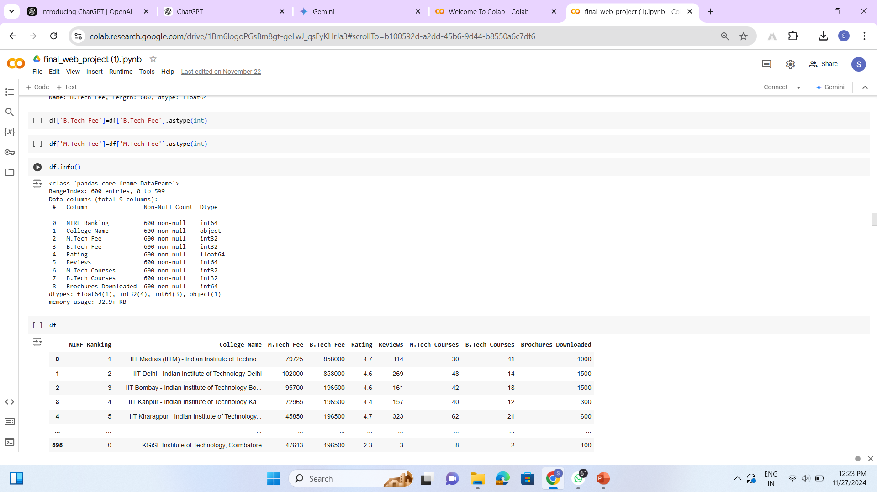
EXPLORATORY DATA ANALYSIS
Data Cleaning: Any missing values or inconsistencies in the data are likely addressed during this step.

Slide 9
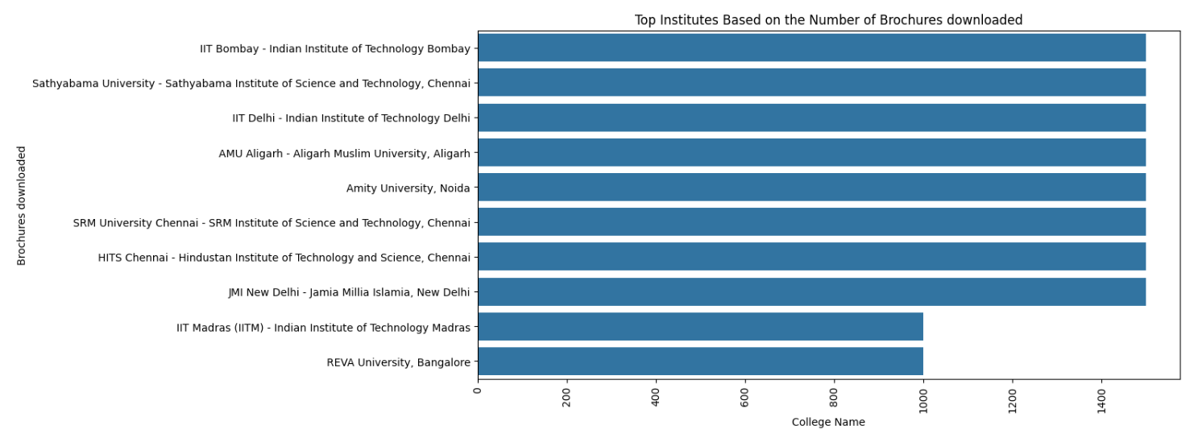
Top Institutes Based on the Number of Brochures downloaded
Insight: IIT Bombay, IIT Delhi, and IIT Madras are the most sought-after institutes based on the number of brochures downloaded, showcasing their high demand and strong reputation among prospective students.

Slide 10
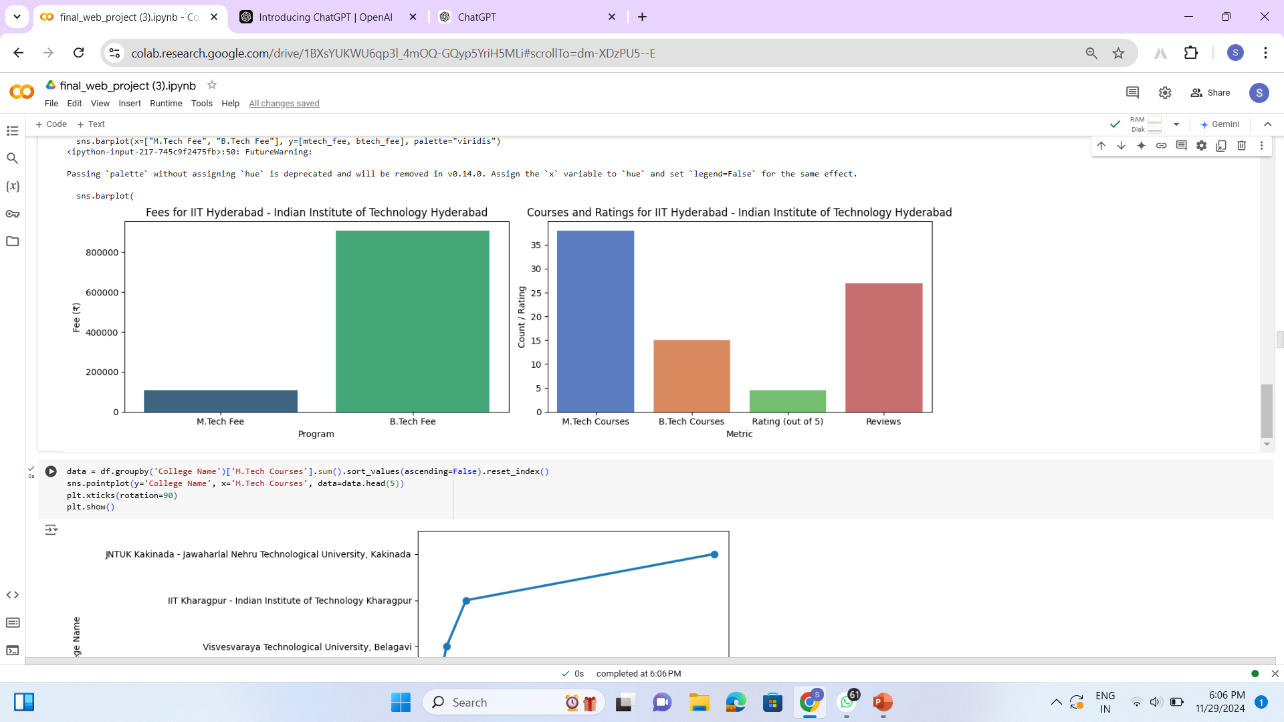
Insight: IIT Hyderabad offers the most comprehensive and highly-rated courses, but at a higher cost. IIT Kharagpur and IIT Delhi provide a good balance of quality and affordability.

Slide 11
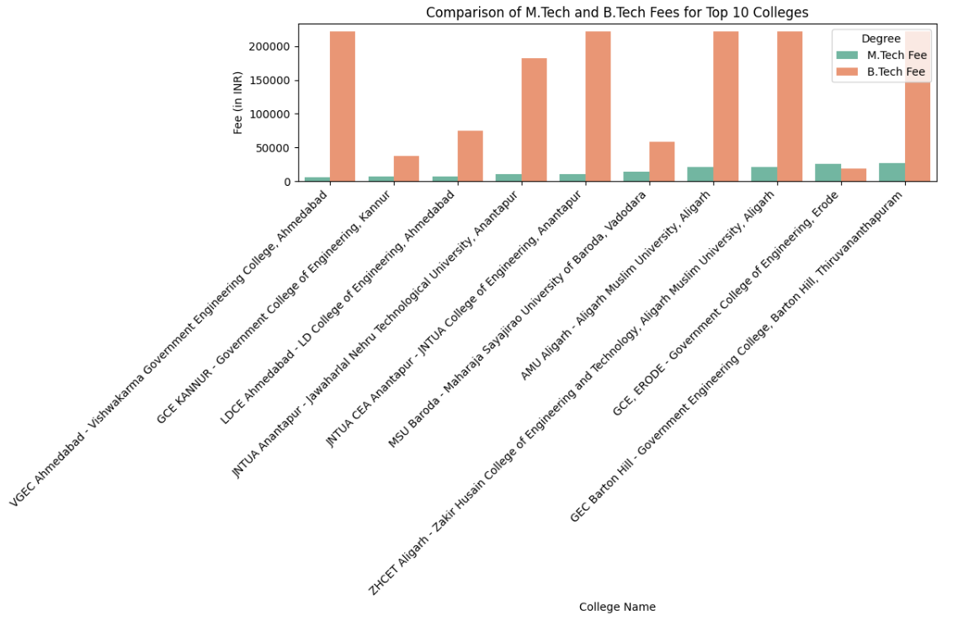
Comparison of M.Tech and B.Tech fees for Top 10 colleges
Insight: B.Tech Fees are Significantly Higher than M.Tech Fees for Top-Ranked Engineering colleges.

Slide 12
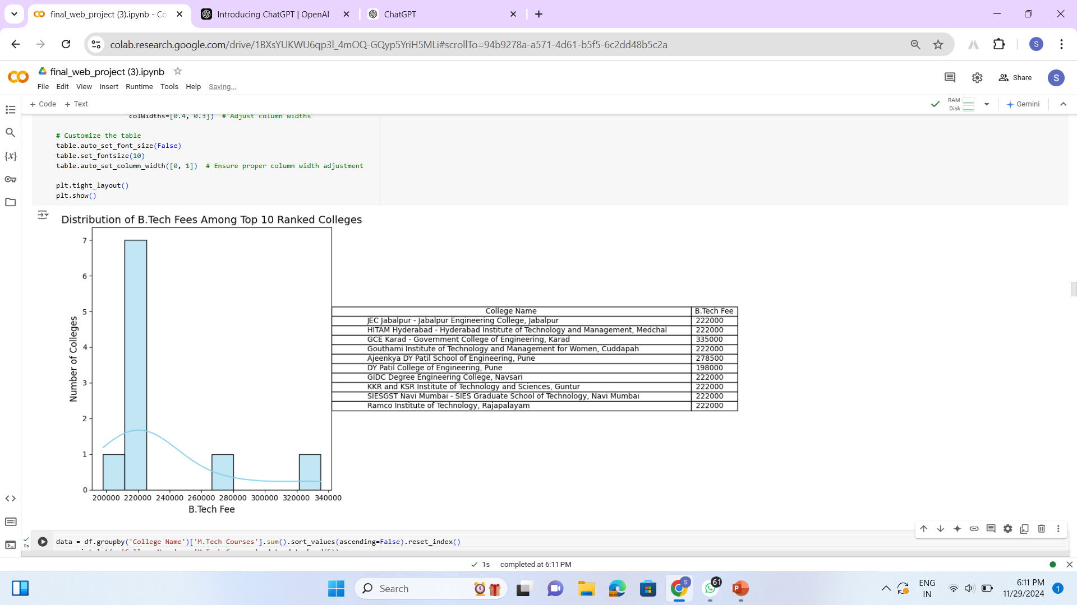
Distribution of B.Tech fees among Top 10 Ranked Colleges
Insight: Most of the colleges have their B.Tech fees clustered around ₹2,22,000, suggesting a standardized fee structure among the majority of top-ranked colleges. The graph shows a uniform fee structure for a majority of colleges.

Slide 13
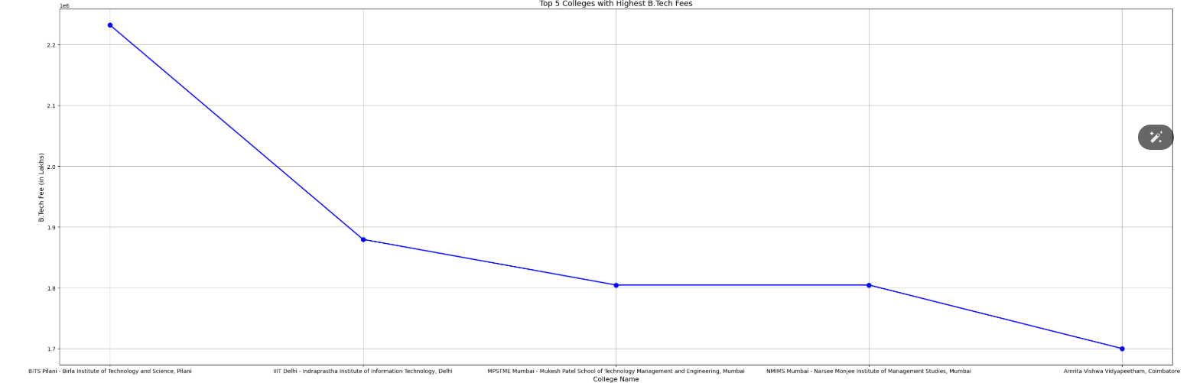
Highest and Lowest fees for B.Tech Programs
Insight: This highlights a significant fee disparity across top-ranked colleges, likely influenced by factors like private vs. government funding and institutional reputation.

Slide 14
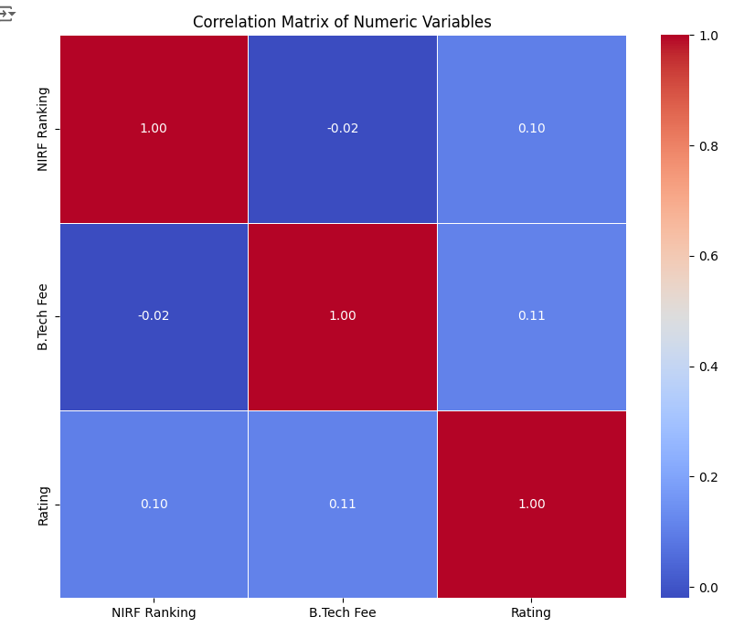
MULTIVARIATE ANALYSIS
NIRF Ranking and B.Tech Fee are not strongly correlated.
This means that a higher NIRF ranking does not necessarily correspond to higher B.Tech fees, and vice versa. Other factors likely influence the fee structure of these top-ranked colleges.

Slide 15
CONCLUSION
The analysis of engineering colleges' data, facilitated by operations like web scraping and data cleaning, provided valuable insights into the educational landscape. The subsequent data cleaning process ensured the dataset's accuracy, consistency, and usability by addressing issues such as missing values, duplicates, and formatting. These steps laid a strong foundation for meaningful analysis, uncovering patterns in student preferences, geographical trends, and institutional popularity. The results not only highlight the demand dynamics among engineering institutions but also serve as a resource for stakeholders to enhance decision-making in areas like marketing, admissions, and academic offerings.

Slide 16

Thank You

